Slide 1

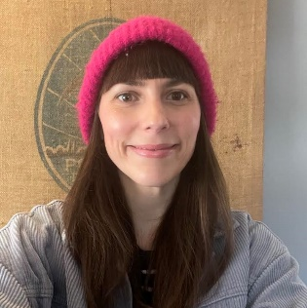
How to Successfully Adopt Power Platform at Scale
Emma-Claire Shaw
Lead Product Manager - Power Platform
Defra Group (UK Central Government)

Slide 2
WELCOME!
Proud Power Platform Product Manager since 2022
Power Platform fan since 2018
Interested in…
  Science fiction and fantasy
  Technology that can improve the world we live in
www.linkedin.com/in/shawemmaclaire/
http://bit.ly/42uu7X6 - UK XGov Community

Slide 3

WHAT WILL YOU LEARN FROM THIS SESSION?
The technology is the easy bit (relatively)
It's a long term journey (not a project)
The need for a continuous user/stakeholder view
The importance of continual prioritization
Ideas for sustainably enabling your community
People are the most important aspect for long term success

Slide 4






Defra’s Journey – Day One!
1,200 apps & 2,700 flows in M365 tenancy and growing!
Largely ungoverned usage – time intensive and impossible to scale
Value demonstrated but challenge realising the benefits in full
Major knowledge fragmentation
~30,000 employees

Slide 5





Fear of security breaches
Lack of guidance for developers
Proliferation of shadow IT
Lack of leadership & strategy
‘Shipwrecked’ solutions
MAIN CHALLENGES
This Photo by Unknown Author is licensed under CC BY-SA-NC

Slide 6
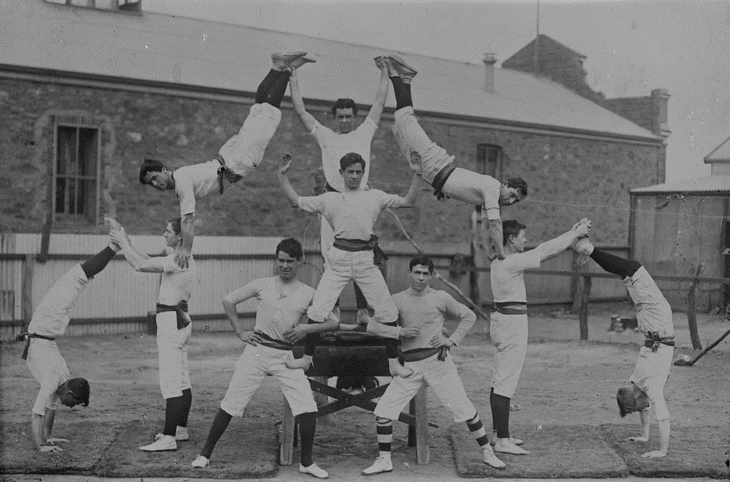

Getting it right is all about people!
IT Project
Biz Maker
IT Stakeholder
Biz Stakeholder
Know your stakeholders
Know your users
Don’t forget the business!
Talk to people & start building feedback loops – you’re here for the long haul!
It’s a PRODUCT not a PROJECT
This Photo by Unknown Author is licensed under CC BY-NC

Slide 7

Plan, Prioritise, Don’t Panic…
The cascade of new features will not stop!
Regularly review maturity
Look at case studies & network
Review Microsoft recommendations
Keep organisational & stakeholder needs front & centre
Utilise support and knowledge within & beyond your organization - think about the long term resourcing you will need
(it’s all about people!)
This Photo by Unknown Author is licensed under CC BY-SA-NC

Slide 8

Strategic Foundation / Technical Foundation / Change & Adoption
The Three Pillars of Successful Adoption
Continuous Evolution
Note: Only one of these is focussed on technology!

Slide 9


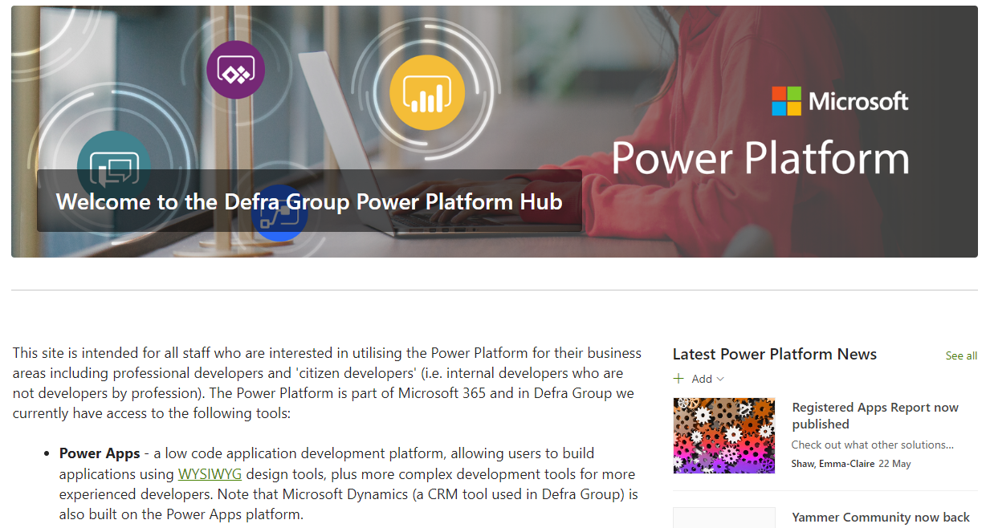












STRATEGIC FOUNDATION
TECHNICAL FOUNDATION
CHANGE AND ADOPTION
  Product Lead
Environment Strategy
Power Platform
Hub
Biz Capabilities
& Guardrails
  Security & DLP
Tell them,
TELL THEM!
Assessment –
LCAPs
Pro Dev Capability
Sponsors
Adaptive Governance
Maker Standards
& Training
  Community
  of Practice
Resourcing Plan
CoE Starter Kit
(++++!)
Benefit Tracking
Golden thread - organisational & user needs

Slide 10

Supercharge adoption at scale
You’re on a journey – don’t ignore your ‘passengers’:
  Keep your early adopters on board
  Keep your stakeholders (biz and IT) sighted and up-to-date
  Keep bringing people on until everyone knows you’re here but be aware of capacity
Focus efforts on sustainable ENABLEMENT
(CoP / training / hackathons / fusion teams)
Use your data:
  Patterns
  Opportunities
  Regular reporting

Slide 11






Biggest challenges
& how to overcome (some of) them
Benefits Tracking
Trust based model
Demanding citizen devs
Promoting re-use
Staying up to date
Model driven apps

Slide 12






RESULTS SO FAR...
3 Delivery Routes Available
30+ Portfolio Apps live
233 Citizen Developed Apps
3,500+ Citizen Developed Flows
Fast Growing Community
Real Quantifiable Benefits!
with clear guidance, self serve routes and support available.
& many more in development by our in house team and partners.
& we know what they are and who is doing them – so do our users!
& quickly growing – Automate adoption has been the biggest growth area.
896 members and counting, with ~100 showing up for monthly meet ups.
From 43 reported flows so far we know that users are saving over 35 days a month!

Slide 13





KEY TAKEAWAYS
People are THE single most important factor in nailing this
Regularly prioritise to remain (relatively) sane
It’s a PRODUCT not a PROJECT
Focus on SUSTAINABLE enablement
Keep everyone on the bus with comms and engagement (TELL THEM!)

Slide 14
QUESTIONS?
Emma-Claire Shaw
Lead Product Manager - Power Platform
Defra Group (UK Central Government)
www.linkedin.com/in/shawemmaclaire/
http://bit.ly/42uu7X6 - UK XGov Community

Slide 15
Further reading
https://www.d365ppug.com/ <- find your local user group!
Microsoft Power Platform Center of Excellence Starter Kit
Establishing an Environment Strategy (includes info on Governance)
Sprint Zero Podcast featuring me talking about how to manage Power Platform as a product ☺
Unlocking the power of low code in Defra (blog on our journey)
http://bit.ly/42uu7X6 - UK XGov Community

Slide 16
ROLES/skills YOU will need*
Adoption
Centre of Enablement
PRODUCT LEAD
LEAD
ARCHITECT
LEAD DEV
DATA ANALYST
ADOPTION LEAD
PRODUCT MANAGER
BUSINESS ANALYST
COMMS LEAD
Governance
Platform
Solutions
WORKING GROUP
PLATFORM ADMIN
SECURITY
IT PROJECT TEAMS
BUSINESS MAKERS
STEERING GROUP
OPERATIONS MANAGER
PRO DEVS
SUPPORT
* One person could (probably will!) be doing more than one role

